Slide 1
09: STRUCTURED DATA

Slide 2
Abstract Data Types

Slide 3
Abstract Data Types
A data type that specifies:
  values that can be stored
  operations that can be done on the values
User of an abstract data type does not need to know the implementation of the data type, e.g., how the data is stored
ADTs are created by programmers

Slide 4
Abstraction and Data Types
Abstraction: a definition that captures general characteristics without details.
  Ex: An abstract triangle is a 3-sided polygon. A specific triangle may be scalene, isosceles, or equilateral
Data Type: defines the values that can be stored in a variable and the operations that can be performed on it

Slide 5
Combining Data into Structures

Slide 6
Introduction to Structures
Structure: C++ construct that allows multiple variables to be grouped together.
General format:
  struct <structName>
  {
  type1 field1;
  type2 field2;
  . . .
  };

Slide 7
Example: struct Declaration
struct Student
{
int studentID;
string name;
short yearInSchool;
double gpa;
};
Structure tag
Structure members

Slide 8
struct Declaration Notes
Must have ; after closing }.
struct names commonly begin with uppercase letter.
Multiple fields of same type can be in comma-separated list:
  string name, address;
struct declaration does not allocate memory or create variables.
To define variables, use structure tag as type name:
Student bill;

Slide 9
Defining Variables
struct declaration does not allocate memory or create variables
To define variables, use structure tag as type name:
Student bill;
bill
studentID
name
yearInSchool
gpa

Slide 10
Accessing Structure Members

Slide 11
Accessing Structure Members
Use the dot (.) operator to refer to members of struct variables:
  cin >> stu1.studentID;
  getline(cin, stu1.name);
  stu1.gpa = 3.75;
General Format: Member variables can be used in any manner appropriate for their data type

Slide 12
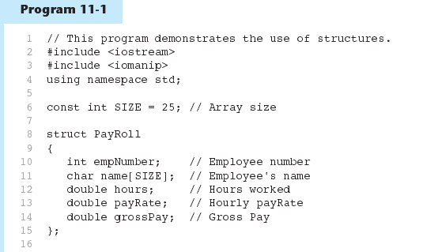
Accessing Structure Members - Example

Slide 13
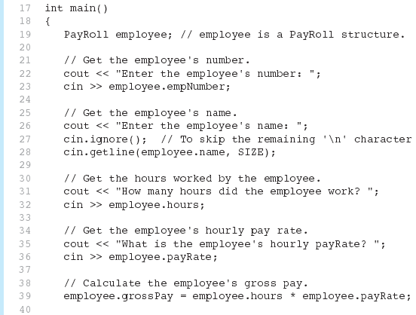
Program 11-1 (Continued)

Slide 14
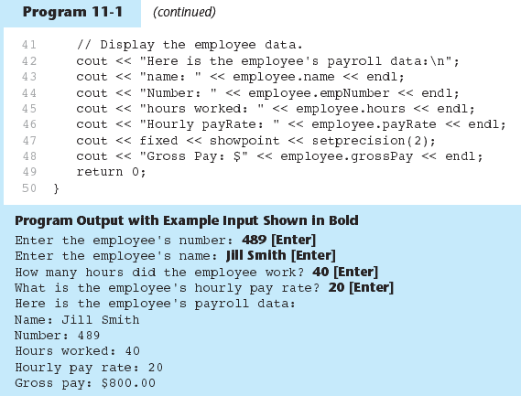
Program 11-1 (Continued)

Slide 15
Displaying a struct Variable
To display the contents of a struct variable, must display each field separately, using the dot operator:
  cout << bill; // won’t work
  cout << bill.studentID << endl;
  cout << bill.name << endl;
  cout << bill.yearInSchool;
  cout << " " << bill.gpa;

Slide 16
Comparing struct Variables
Cannot compare struct variables directly:
if (bill == william)
// won’t work
Instead, must compare on a field basis:
if (bill.studentID ==
william.studentID) ...

Slide 17
Initializing a Structure

Slide 18
Initializing a Structure
struct variable can be initialized when defined:
Student s = {11465, "Joan", 2, 3.75};
Can also be initialized member-by-member after definition:
s.name = "Joan";
s.gpa = 3.75;

Slide 19
More on Initializing a Structure
May initialize only some members:
Student bill = {14579};
Cannot skip over members:
Student s = {1234, "John", ,
2.83}; // illegal
Cannot initialize in the structure declaration, since this does not allocate memory

Slide 20
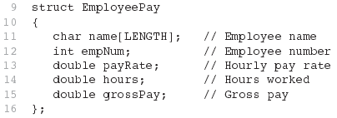
Example 1

Slide 21
Array of Structures

Slide 22
Arrays of Structures
Structures can be defined in arrays
Can be used in place of parallel arrays
const int NUM_STUDENTS = 20;
Student stuList[NUM_STUDENTS];
Individual structures accessible using subscript notation
Fields within structures accessible using dot notation:
cout << stuList[5].studentID;

Slide 23
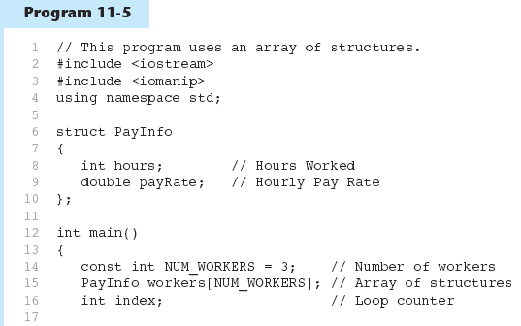
Arrays of Structures-Example

Slide 24
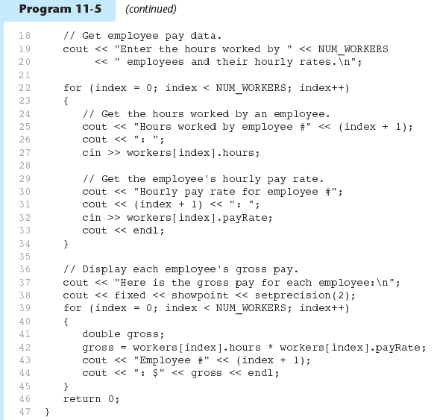
Arrays of Structures- Example

Slide 25
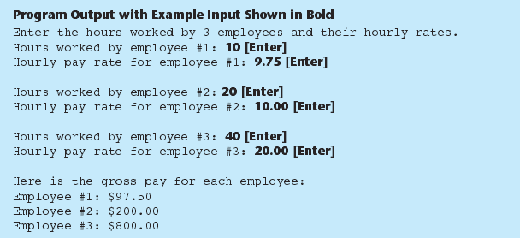
Arrays of Structures- Example

Slide 26
Nested Structures

Slide 27
Nested Structures
  A structure can contain another structure as a member:
  struct PersonInfo
  { string name,
  address,
  city;
  };
  struct Student
  { int studentID;
  PersonInfo pData;
  short yearInSchool;
  double gpa;
  };

Slide 28
Members of Nested Structures
  Use the dot operator multiple times to refer to fields of nested structures:
  Student s;
  s.pData.name = "Joanne";
  s.pData.city = "Tulsa";

Slide 29
Structures as Function Arguments

Slide 30
Structures as Function Arguments
May pass members of struct variables to functions:
computeGPA(stu.gpa);
May pass entire struct variables to functions:
showData(stu);
Can use reference parameter if function needs to modify contents of structure variable

Slide 31
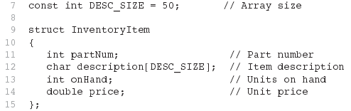
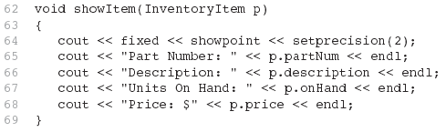
Example 2

Slide 32
Structures as Function Arguments - Notes
Using value parameter for structure can slow down a program, waste space
Using a reference parameter will speed up program, but function may change data in structure
Using a const reference parameter allows read-only access to reference parameter, does not waste space, speed up program

Slide 33
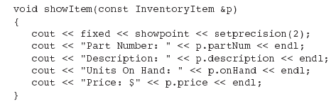
Revised showItem Function

Slide 34
Returning a Structure from a Function

Slide 35
Returning a Structure from a Function
Function can return a struct:
Student getStudentData(); // prototype
stu1 = getStudentData(); // call
Function must define a local structure
  for internal use
  for use with return statement

Slide 36
Returning a Structure from a Function - Example
  Student getStudentData()‏
  { Student tempStu;
  cin >> tempStu.studentID;
  getline(cin, tempStu.pData.name);
  getline(cin, tempStu.pData.address);
  getline(cin, tempStu.pData.city);
  cin >> tempStu.yearInSchool;
  cin >> tempStu.gpa;
  return tempStu;
  }

Slide 37
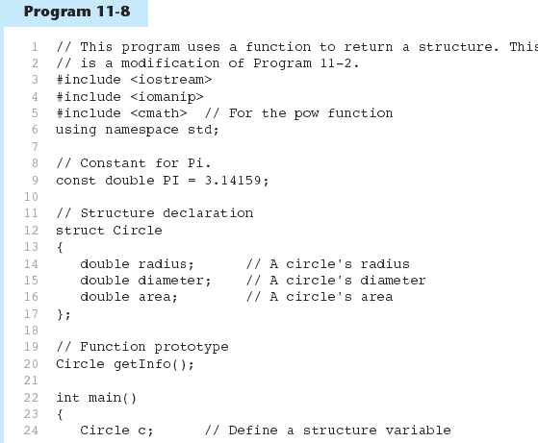
Returning a Structure from a Function - Example

Slide 38
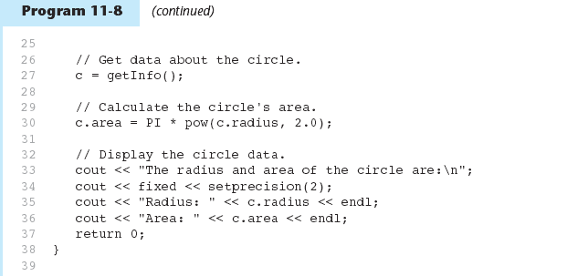
Program 11-8 (Continued)‏

Slide 39
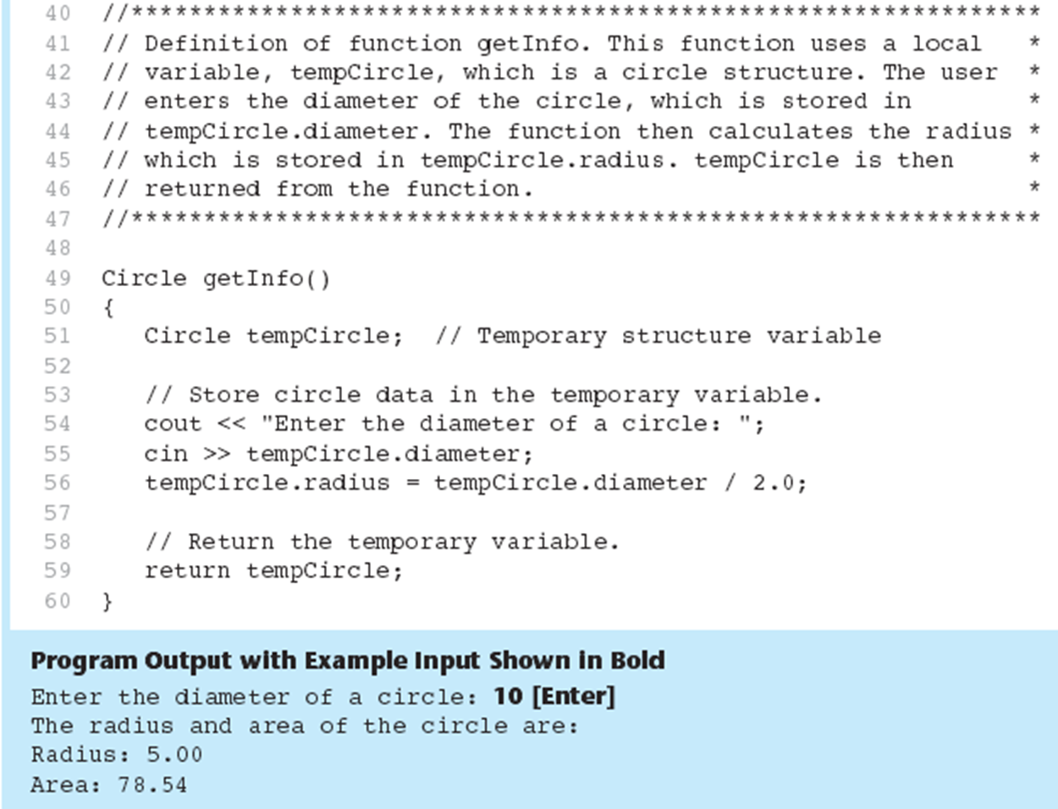
Program 11-8 (Continued)‏

Slide 40
Pointer to Structure
We stop here

Slide 41
Pointers to Structures
A structure variable has an address
Pointers to structures are variables that can hold the address of a structure:
Student *stuPtr;
Can use & operator to assign address:
stuPtr = & stu1;
Structure pointer can be a function parameter

Slide 42
Accessing Structure Members via Pointer Variables
Must use () to dereference pointer variable, not field within structure:
cout << (*stuPtr).studentID;
Can use structure pointer operator to eliminate () and use clearer notation:
cout << stuPtr->studentID;

Slide 43
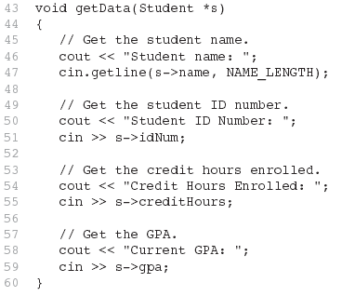
Example 3

Slide 44
Unions

Slide 45
Unions
Similar to a struct, but
  all members share a single memory location, and
  only one member of the union can be used at a time
Declared using union, otherwise the same as struct
Variables defined as for struct variables

Slide 46
Anonymous Union
A union without a union tag:
union { ... };
Must use static if declared outside of a function
Allocates memory at declaration time
Can refer to members directly without dot operator
Uses only one memory location, saves space

Slide 47
Enumerated Data Types

Slide 48
Enumerated Data Types
An enumerated data type is a programmer-defined data type. It consists of values known as enumerators, which represent integer constants.
Example:
enum Day { MONDAY, TUESDAY,
WEDNESDAY, THURSDAY,
FRIDAY };
The identifiers MONDAY, TUESDAY, WEDNESDAY, THURSDAY, and FRIDAY, which are listed inside the braces, are enumerators. They represent the values that belong to the Day data type.

Slide 49
Enumerated Data Types
enum Day { MONDAY, TUESDAY,
WEDNESDAY,THURSDAY,
FRIDAY };
Note that the enumerators are not strings, so they aren’t enclosed in quotes.
They are identifiers.

Slide 50
Enumerated Data Types
Once you have created an enumerated data type in your program, you can define variables of that type. Example:
Day workDay;
This statement defines workDay as a variable of the Day type.
We may assign any of the enumerators MONDAY, TUESDAY, WEDNESDAY, THURSDAY, or FRIDAY to a variable of the Day type. Example:
workDay = WEDNESDAY;

Slide 51
Enumerated Data Types
So, what is an enumerator?
Think of it as an integer named constant
Internally, the compiler assigns integer values to the enumerators, beginning at 0.

Slide 52
Enumerated Data Types
enum Day { MONDAY, TUESDAY,
WEDNESDAY,THURSDAY,
FRIDAY };
In memory...
MONDAY = 0
TUESDAY = 1
WEDNESDAY = 2
THURSDAY = 3
FRIDAY = 4

Slide 53
Enumerated Data Types
Using the Day declaration, the following code...
cout << MONDAY << " "
<< WEDNESDAY << " “
<< FRIDAY << endl;
will produce this output:
0 2 4

Slide 54
Assigning an integer to an enum Variable
You cannot directly assign an integer value to an enum variable. This will not work:
workDay = 3; // Error!
Instead, you must cast the integer:
workDay = static_cast<Day>(3);

Slide 55
Assigning an Enumerator to an int Variable
You CAN assign an enumerator to an int variable. For example:
int x;
x = THURSDAY;
This code assigns 3 to x.

Slide 56
Comparing Enumerator Values
Enumerator values can be compared using the relational operators. For example, using the Day data type the following code will display the message "Friday is greater than Monday.“
if (FRIDAY > MONDAY)
{
cout << "Friday is greater "
<< "than Monday.\n";
}

Slide 57
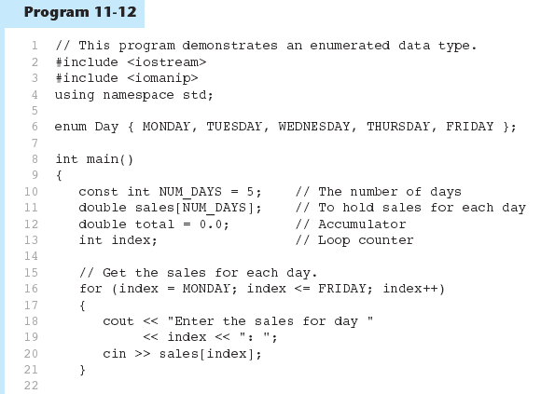
Comparing Enumerator Values - Example

Slide 58
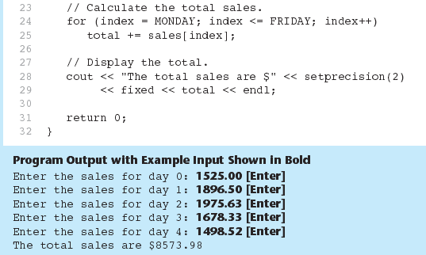
Program 11-12 (Continued)

Slide 59
Enumerated Data Types
Program 11-12 shows enumerators used to control a loop:
// Get the sales for each day.
for (index = MONDAY; index <= FRIDAY; index++)
{
cout << "Enter the sales for day "
<< index << ": ";
cin >> sales[index];
}

Slide 60
Anonymous Enumerated Types
An anonymous enumerated type is simply one that does not have a name. For example, in Program 11-13 we could have declared the enumerated type as:
enum { MONDAY, TUESDAY,
WEDNESDAY, THURSDAY,
FRIDAY };

Slide 61
Using Math Operators with enum Variables
You can run into problems when trying to perform math operations with enum variables. For example:
Day day1, day2;
// Define two Day variables.
day1 = TUESDAY;
// Assign TUESDAY to day1.
day2 = day1 + 1;
// ERROR! Will not work!
The third statement will not work because the expression day1 + 1 results in the integer value 2, and you cannot store an int in an enum variable

Slide 62
Using Math Operators with enum Variables
You can fix this by using a cast to explicitly convert the result to Day, as shown here:
// This will work.
day2 = static_cast<Day>(day1 + 1);

Slide 63
Using an enum Variable to Step through an Array's Elements
Because enumerators are stored in memory as integers, you can use them as array subscripts. For example:
enum Day { MONDAY, TUESDAY, WEDNESDAY,
THURSDAY, FRIDAY };
const int NUM_DAYS = 5;
double sales[NUM_DAYS];
sales[MONDAY] = 1525.0;
sales[TUESDAY] = 1896.5;
sales[WEDNESDAY] = 1975.63;
sales[THURSDAY] = 1678.33;
sales[FRIDAY] = 1498.52;

Slide 64
Using an enum Variable to Step through an Array's Elements
Remember, though, you cannot use the ++ operator on an enum variable. So, the following loop will NOT work.
Day workDay; // Define a Day variable
// ERROR!!! This code will NOT work.
for (workDay = MONDAY; workDay <= FRIDAY; workDay++)‏
{
cout << "Enter the sales for day "
<< workDay << ": ";
cin >> sales[workDay];
}

Slide 65
Using an enum Variable to Step through an Array's Elements
You must rewrite the loop’s update expression using a cast instead of ++:
for (workDay = MONDAY; workDay <= FRIDAY;
workDay = static_cast<Day>(workDay + 1))‏
{
cout << "Enter the sales for day "
<< workDay << ": ";
cin >> sales[workDay];
}

Slide 66
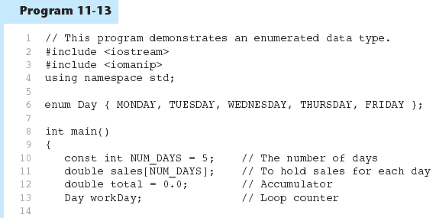
Using an enum Variable to Step through an Array's Elements - Example

Slide 67
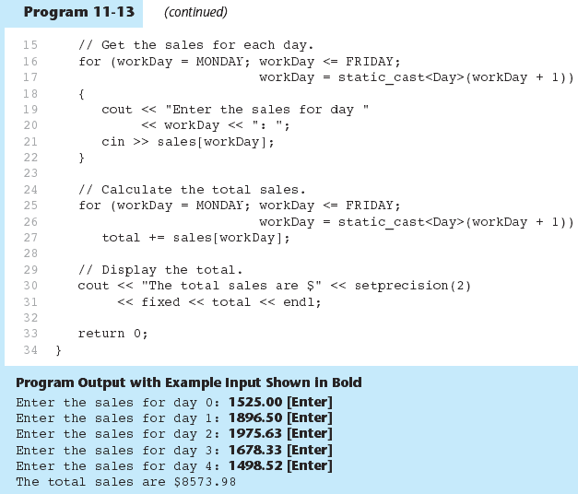
Using an enum Variable to Step through an Array's Elements - example

Slide 68
Enumerators Must Be Unique Within the same Scope
Enumerators must be unique within the same scope. For example, an error will result if both of the following enumerated types are declared within the same scope:
enum Presidents { MCKINLEY, ROOSEVELT, TAFT };
enum VicePresidents { ROOSEVELT, FAIRBANKS,
SHERMAN };
ROOSEVELT is declared twice.

Slide 69
Declaring the Type and Defining the Variables in One Statement
You can declare an enumerated data type and define one or more variables of the type in the same statement. For example:
enum Car { PORSCHE, FERRARI, JAGUAR } sportsCar;
This code declares the Car data type and defines a variable named
sportsCar.

